Slide 1
Predicting ‘Investment’ Portfolio Returns
By Luis Lu, Tracy Lao, Abigail Urmenta and Damien Nguyen

Slide 2
Our motivations and goals
“Our motivation is to develop a machine learning model which can be used to help us determine the best investment portfolio of selected stocks to generate the maximum returns for the client."

Slide 3
Machine learning: Supervised Learning
We decided on the use of Supervised learning in order to train our AI.
Why Machine learning?: When it comes to predicting portfolio returns machine learning relevance is vital. Machine learning has proven itself to be essential in the world of trading. This is due to machine learnings’ many algorithms and deep learning techniques that make this a viable option. The model assigns variables to each stock which is determined by access to the stocks historical data in order to be able to predict future stocks.

Slide 4
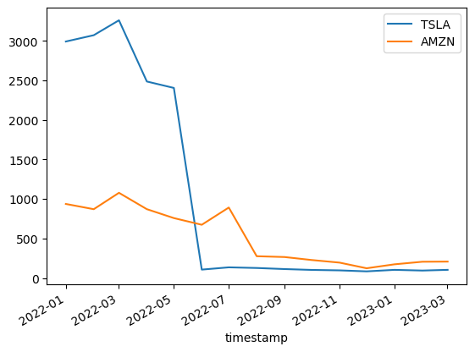
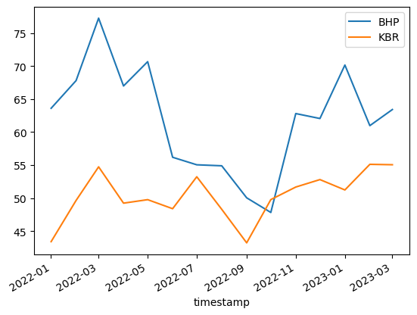
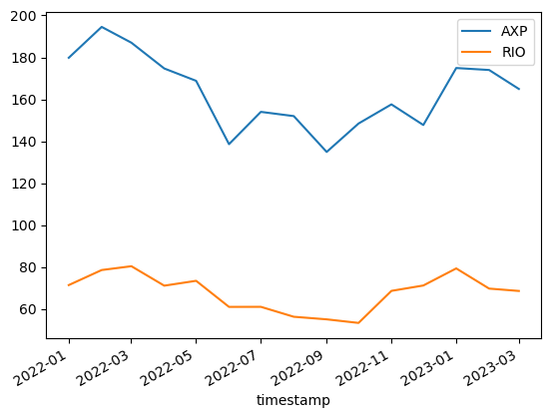
Creation of Our Model
Where did we get the data?: By using the alpaca API we managed to obtain live data and historical data on the markets we were researching
What did we do with the data?: In order for our program to work we separated each stock and assigned them into data frames. We then cleaned up the data, then combined each stock dataset into one bucket. By using a SVR model as our primary and neighbour model being our secondary, we trained and tested the combined data to observe our findings with the portfolios’ return
Obstacles that were faced? When it came to combining the dataset into one portfolio there was difficulty with writing up the code as the datasets wouldn’t combine due to specific/extra steps that had to be taken. Following this there was issues into formulating the prediction codes but easy to get through.

Slide 5
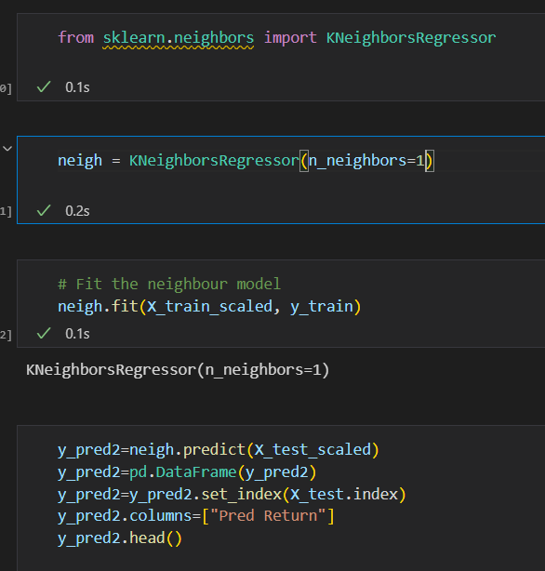
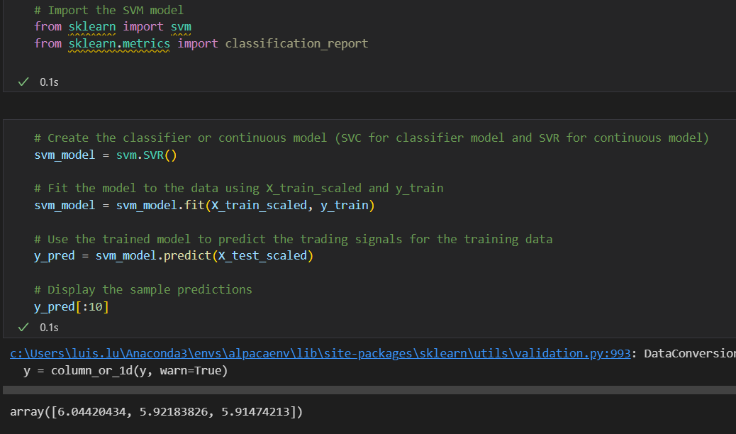
Deep Learning Techniques
What techniques were used to observe its performance?
As mention before, we used two models “Support Vector Regression (SVR)” and “K-nearest neighbours (KNN)” with SVR being our primary and the latter being our back test model. SVR is a regression model the will help fit the best line within a threshold of values. It is also regarded as reliable and is a popular technique model to use as it can used for classification problems and assigning classes of data points.
Similar to SVR, KNN is also a supervised classifier, its algorithm assists us in making predictions for our combined portfolio. We use a large amount of training data, where the data points is characterised.

Slide 6
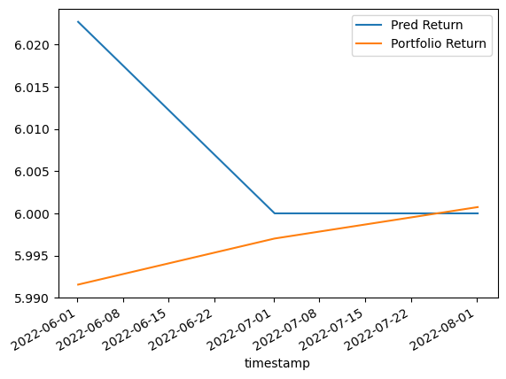
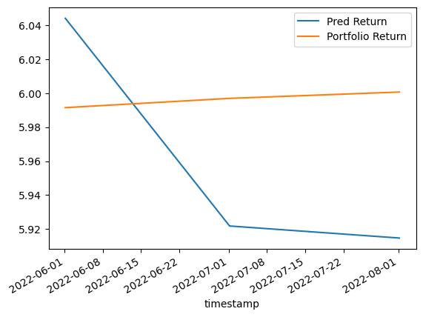
Discovery & Results
KNN plot
Did it work? We finally finished the model and ensure that it works with its prediction being close estimates to the actual values of the portfolio returns. However to validate the validity of our code we must make sure the model is valid by back testing the KNN model to compare the two data. Fortunately for us the KNN model also shows similar results. We discovered that the KNN models prediction lies slightly higher than the SVR. Overall however with the two models values residing closely to on another we are confident with the support of the graph plots and back testing data. Our findings show that the model is suitable and works for predicting portfolio returns.
SVR plot

Slide 7
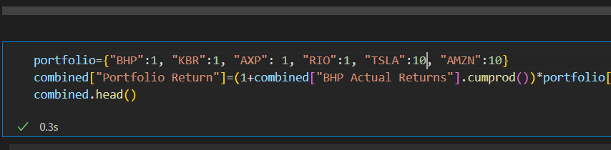
Tunning 1 – Increasing Technology Stick Shares
We also tuned the models by adjusting the investment portfolio
Adjust 1: increase the shares of the technology stocks (Tesla and Amazon)

Slide 8
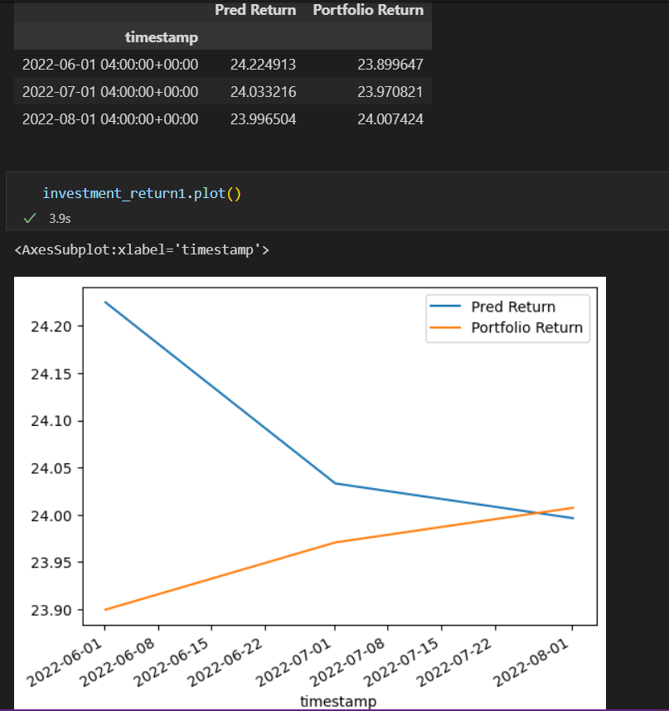
Tunning 1- SVR Model

Slide 9
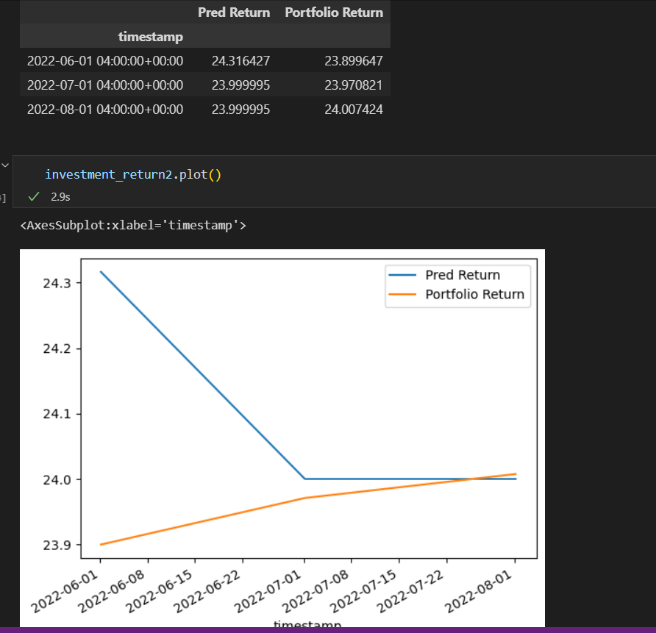
Tunning 1 – Neighbors Model

Slide 10
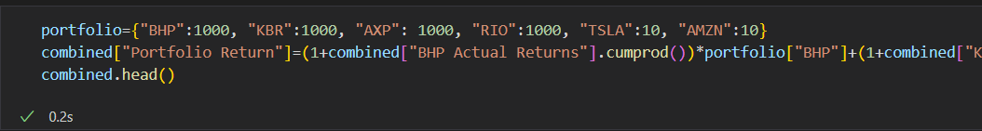
Tunning 2 – Increasing Traditional Stock Shares
Adjust 2: increase the traditional stocks (KBR, AEX, RIO and BHP)

Slide 11
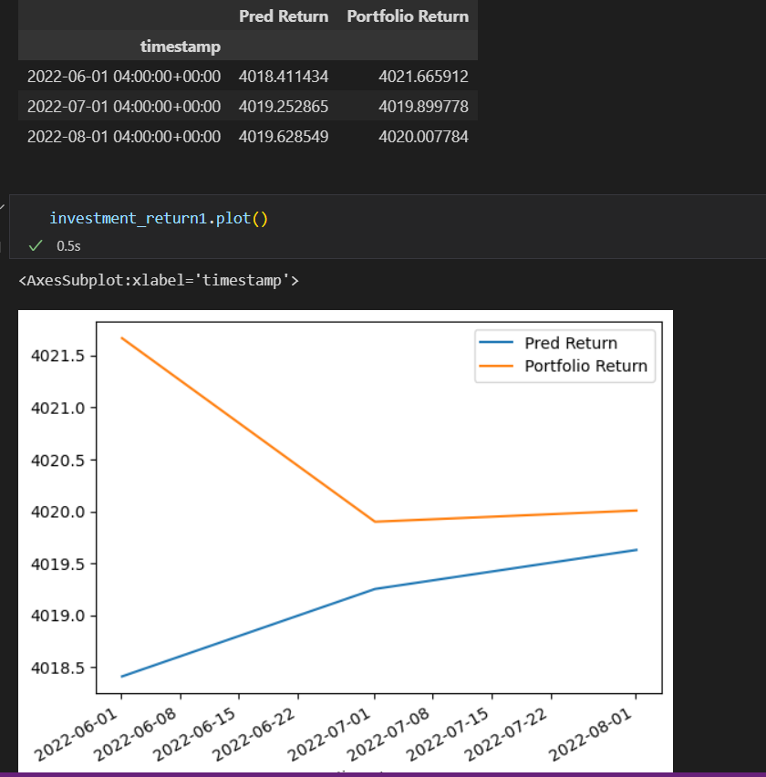
Tunning 2 – SVR Model

Slide 12
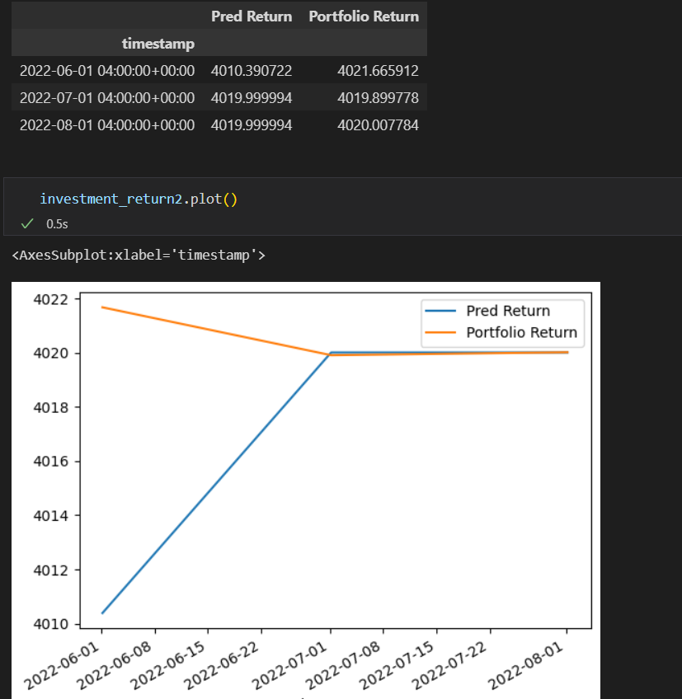
Tunning 2 – Neighbors Model

Slide 13
Adversities and Trials
Challenges: As mentioned before we had difficulties when it came to combing all the separate datasets together, as well as training and testing model. There were also issues of preparing the data, where we realised that in order to combine our portfolios we needed to have similar structures to one another. This caused us to adjust our code so it would be able to align together With every problem that occurred we would all work together in order to solve the ordeal, with everyone's support we managed to overcome issues quickly via solving and correcting ones work. Overall there wasn’t much difficulty other than that, turn to be more or less time consuming on some parts than others.
If we had more time?: With the constricted time frame it definitely limited us seeking more in-depth data and having extra time would of helped us gather more market stocks into our combined portfolio to have a wider range of stocks in our bucket to review the accuracy and the potential of our code. Furthermore we would also be use the time to create more variations of our model to back test and research the possibilities with our code.

Slide 14
Q&A
ANY QUESTIONS?

